Slide 1
Addressing Gaps in European Earth Observation Infrastructure, Services, and Knowledge:
The GEO DAB possible contributions
Stefano Nativi and Mattia Santoro (CNR-IIA)

Slide 2
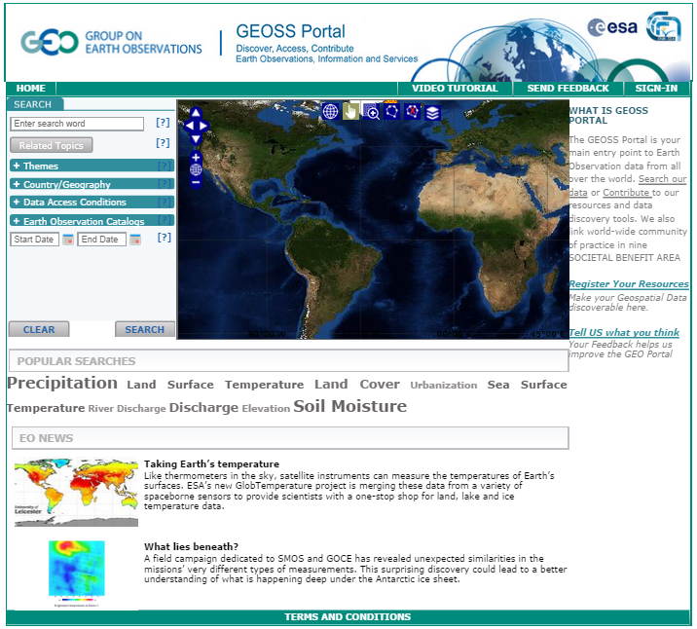
GEOSS end-Users
DOWNSTREAM
GEOSS Web Portal
GEOSS Applications
GEOSS Applications
GEOSS Applications
GEOSS Applications
GEOSS Application Developers
(intermediate Users)
GCI Developers
GCI
DAB
(Discovery and Access Broker)
GEOSS Community
Environment
MIDSTREAM
SUPPLY SYSTEM
Enterprise System 1
… .
System 4
Enterprise System 3
Enterprise System 1
Enterprise System 2
Enterprise System 2
Enterprise System 3
Enterprise System 2
… .
Enterprise System 3
System 4
System 4
Enterprise System Z
Enterprise System 1
SBA 8
… .
… .
Enterprise System j
Enterprise System K
UPSTREAM
SBA 1
SBA 2
GEOSS Providers

Slide 3
DOWNSTREAM
GEOSS end-Users
GEOSS
intermediate Users
GCI Developers
MIDSTREAM
GAPS
USERS NEEDS
UPSTREAM
GEOSS Providers

Slide 4
The High-level Process
Gaps recognition
Gaps addressing
GEOSS User needs
Top-down analysis

Slide 5
GAPS RECOGNITION Bottom-UP approach

Slide 6
Gaps Recognition Process
USERS
Resource
Metadata
GEOSS KB
USER NEEDS
Possible Gaps
GEOSS KB

Slide 7
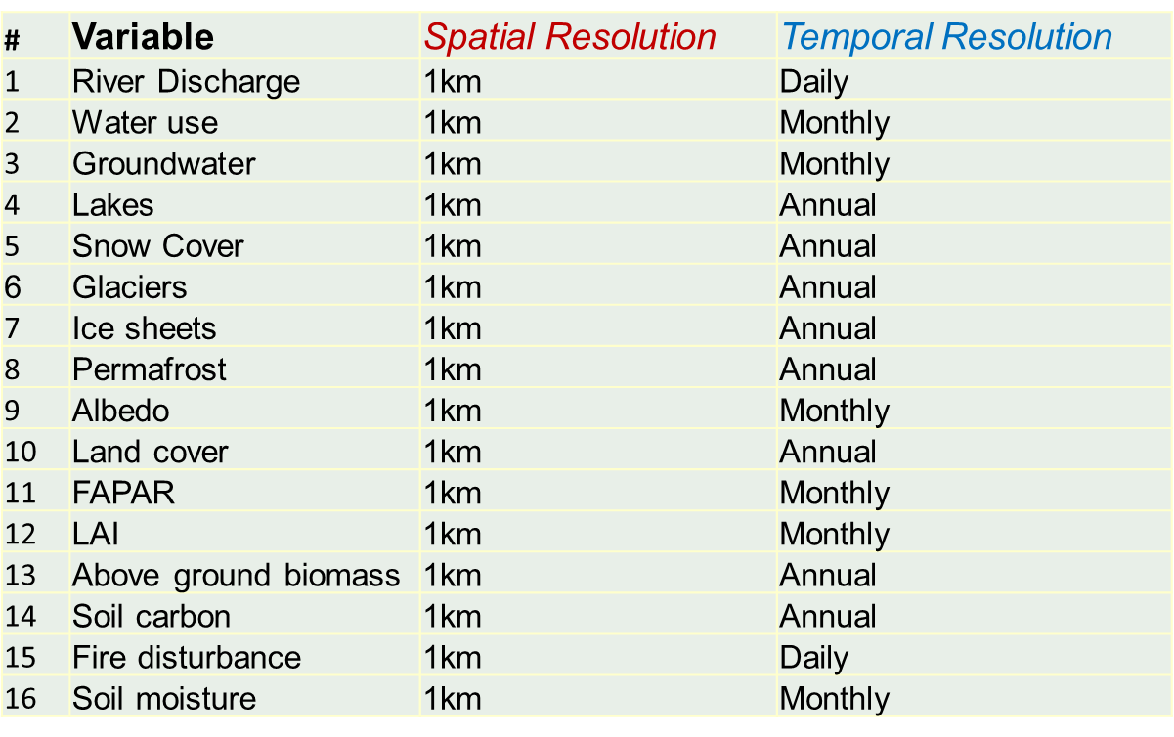
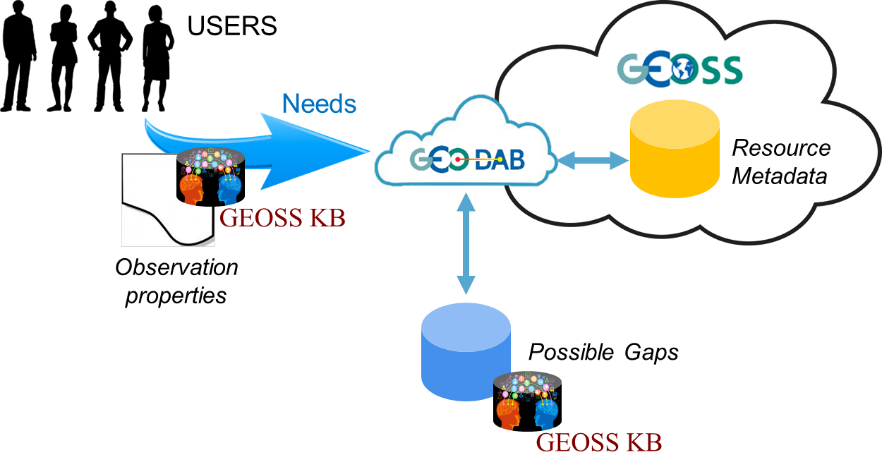
Gaps Recognition Process

Slide 8
Gaps Recognition Process
⬥
◆
Metadata Analyzer
Metadata Enricher
❖
Resource
Enriched
Metadata
Analyzer

Slide 9
Metadata Enrichers
Web Resource Filter/Enricher
Harvest
Record Filter/Enricher
Accessibility Check
Data Filter/Enricher
Add Tags
Spatial Resolution normalization (km)
Metadata change
Improve Discoverability
Temporal Resolution normalization (day)
Metadata change
… .
Document Enricher
… .

Slide 10
Possible Gaps
Number of Discoverable Resources
Number of Accessible Resources
Relaxed constraints

Slide 11
User Needs Matching
Discovery Constraint | Regular match | Relaxed match
EV name | Match in Title or Keyword | Match in Title or Keyword or Abstract
Spatial Resolution | <= Required Resolution | Is specified
Temporal Resolution | <= Required Resolution | Is specified

Slide 12
Regular Match: Text

Slide 13
Regular Match: Text + Spatial Resolution

Slide 14
Regular Match: Text + Spatial + Temporal Resolutions

Slide 15
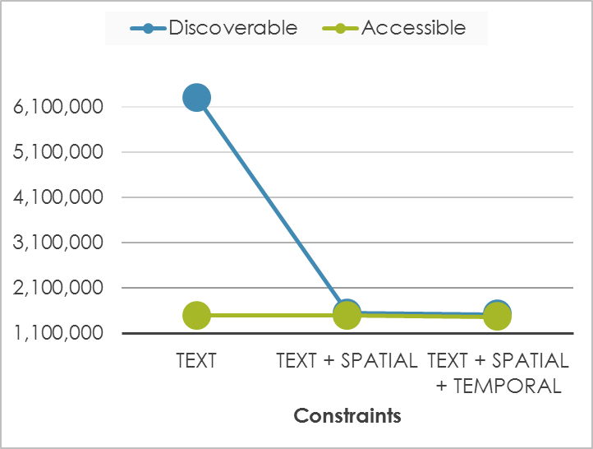
Regular Match: Trend

Slide 16
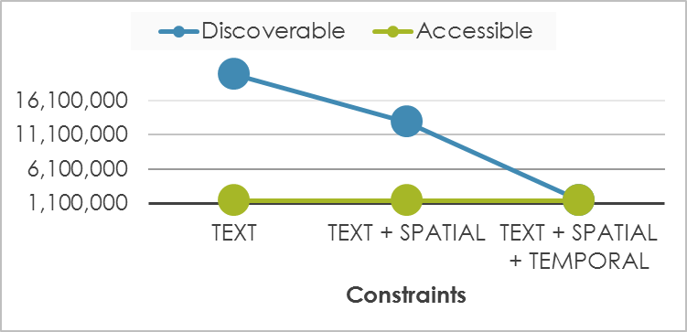
Relaxed Match: Trend

Slide 17
Analysis: Some considerations

Slide 18
First analysis
About 1.5M resources match user needs and are “directly” accessible
Additional 4.5M resources match user needs and are but they are not “directly” accessible
About 9M resources are likely to be instrumental for generating the searched EVs (i.e. discoverable if the relaxed approach is applied:)
Fully described resources (including Spatial and Temporal resolutions) are “directly” accessible, mostly
Resolutions are not provided in Metadata, commonly –the DAB-based metadata enriching module addresses this issue and improves discoverability

Slide 19
Analysis: possible Gap Types
Lack of registered resources
Explanation
Resources exist but are note registered in GEOSS (GEOSS Gap)
Resources do not exist (GEO Community GAP)
Registered resources do not emerge (GEOSS Infrastructure Gap)

Slide 20
Lack of registered resources
Possible missing resources
Missing variable (with right accuracy)
Missing space resolution (on a given area)
Missing time resolution (on a given time period)

Slide 21
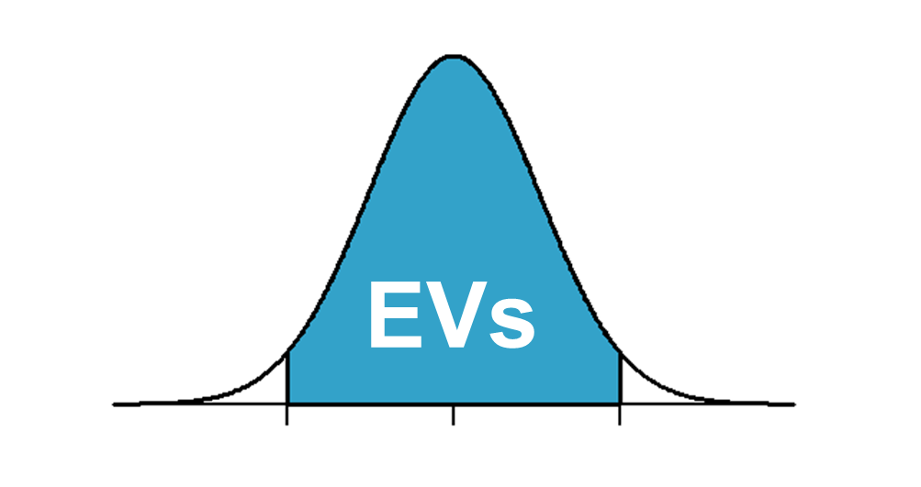
Lack of required EVs
GEOSS contains many “raw” data that are instrumental to generate the searched EVs
Example (satellite/sensor observations):
Raw data Level 1x (Instrument data extracted at full original resolution, with geolocation and calibration information)
Variable Level 2 (Geophysical quantity retrieved from single instrument data in original instrument projection)
Variable Level 3 (Geophysical quantity retrieved from single instrument data, mapped on uniform space and time grid)
Variable Level 4 (Composite multi-sensor and/or multi-satellite product or result of model analysis of lower level data)

Slide 22
GEOSS Infrastructure Gaps
Discovery limitations
User needs are unclear (e.g. imprecise keywords)
Discovery metadata
incomplete
imprecise/unstructured
granularity issue
Access limitation
Access metadata
incomplete
granularity issue
No “direct” access
Access via “landing page(s)”
Access requires an (personal) account

Slide 23
GAPS ADDRESSING the DAB role

Slide 24
User-focused actions
User tags
EVs
Downstream
User needs
GEOSS KB
Goal: Improve User needs specification and matching
Action: Consider EVs and its properties definition
Action: Serve specific User-focused pilots implementation
Action: Consider User feedbacks and tags
Action: Advance GEO DAB APIs (e.g. GEOSS “Views”)
… .

Slide 25
User-focused actions
From Observations to EVs
Useful Workflows
Downstream
User tags
GEOSS KB
Goal: Link “raw” data to EVs
Action: Discover “raw” data that are instrumental for / related to for EVs
Action: Broker third-party “Workflows” useful to move from raw data to Evs
Actions: Consider / return user tags on the subject
… .

Slide 26
Resource Providers-driven actions
Required Sources
Story cases
GEOSS KB
Upstream
Goal: register missing resources
Action: recognize and broker new Providers
Action: support story cases implementation
…
… .

Slide 27
Resource Providers-driven actions
Quality Rank
Usage stats
Required Quality
User feedbacks
Goal: Improve discovery and access metadata
Action: Enrich brokered Metadata
Action: Privilege systems applying the GEOSS Data Sharing and Management Principles
Action: Use quality to rank results
Action: Give to Providers usage feedbacks
… .
GEOSS KB
Upstream

Slide 28
Possible Action types for the DAB
Middleware actions
Goal: facilitate EVs generation
Action: discover and access workflows to generate EVs from observations
Action: associate workflows to managed data
Action: facilitate workflows execution
Action: consider User feedbacks
.. .
Workflows
GEOSS KB
IaaS/PaaS
info

Slide 29
Thank you !
Questions ?

